Slide 1
Cancer Biology Biol 445
Fall 2015
Dr. Heidi Super
Lecture 1
10-2-2015

Slide 2
Announcements
Next Tuesday---Oct. 6, visiting radiology department (tour) and radiologist, Dr. Ken Keller.
Please meet at 1:15-1:20 in ER. (Radiology is right around the corner from check in desk)
Tour first
Dr. Keller’s lecture second

Slide 3
Where were we?
What kind of proteins are encoded by oncogenes?
Growth factors---give an example from your book.
Growth factor receptors---example?
Cytoplasmic adaptor proteins ---(found near the cytoplasmic side of the receptor)—example?

Slide 4
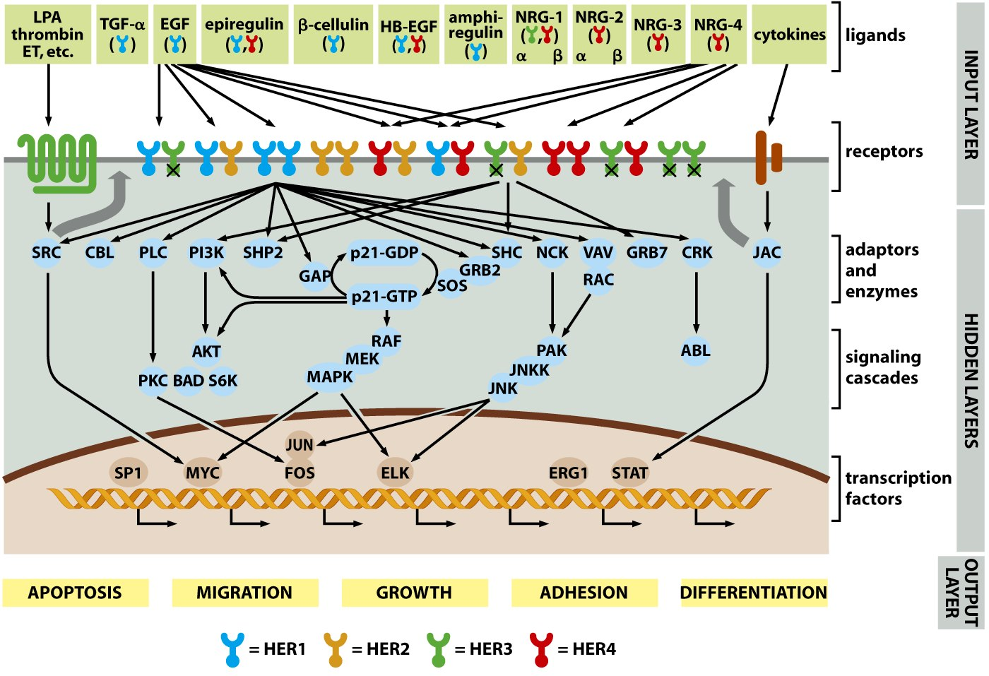

Slide 5
Back to Ras protein
Ras-MAPK pathway has the key events we have discussed in all signal transduction.
…binding of GF, then phosphorylation of tyrosine on the receptor… (9-8)

Slide 6
Ras acts just under the plasma membrane (near the cytoplasmic tails of receptor tyrosine kinases).
Ras is a member of a class of proteins called G-proteins
--G-proteins are regulated by binding of the of guanine nucleotides GDP and GTP.

Slide 7
Ras cycles between the GTP bound form and the GDP bound form. Binding of GTP activates Ras protein, whereas loss of a phoshphate converts Ras to its inactive form.
Figure 9-11

Slide 8
2 adaptor proteins convert GTP to GDP and vice versa.
Guanine-nucleotide exchange factor (GEF)
GTPase activating protein (GAP)

Slide 9
Recall the event that turns the proto-oncogene RAS into the oncogene?
These point mutations lock RAS into its GTP bound/active form. RAS behaves as if it is receiving a signal from a growth factor---even when it is not.

Slide 10
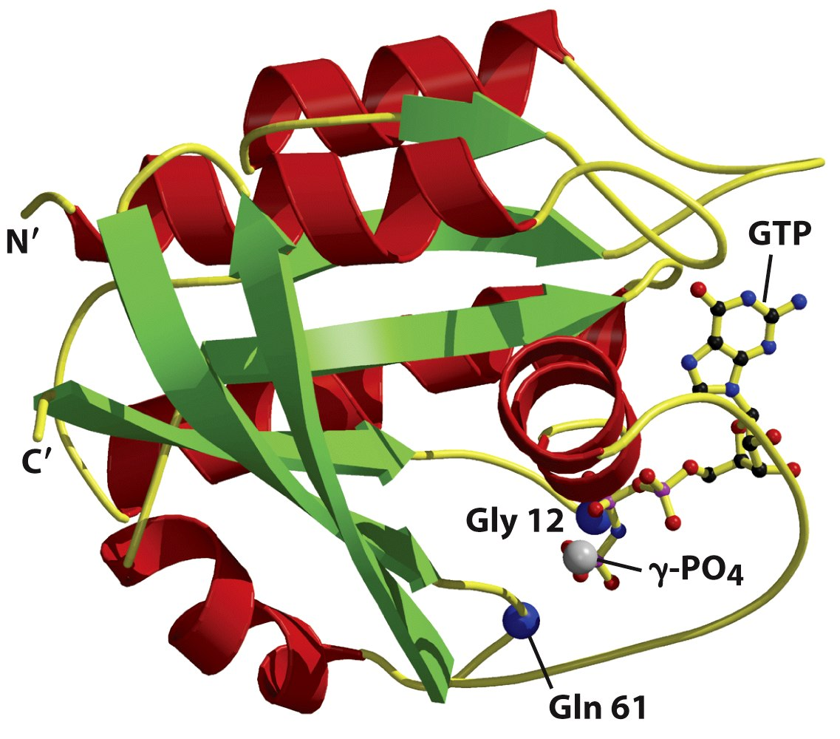
Figure 5.31 The Biology of Cancer (© Garland Science 2007)

Slide 11
GTP-bound form of RAS

Slide 12
Important amino acids gly 12 and gln 61 end up in the GTP-binding pocket of Ras protein

Slide 13
Something to ponder…
RAS mutations are random (can happen anywhere in the RAS gene) but those that affect the activity of RAS---to make it constitutively active, are associated with cancer---they are selected for---so we see them!

Slide 14
Is RAS that important?
Evidence
High incidence of RAS mutation in many types of cancer.
Transfection with mutant RAS genes makes some normal cell lines serum-independent.
Antibodies which block the activity of Ras protein slows or blocks cell division in cell lines

Slide 15
Downstream of RAS…
Activated RAS initiates a cascade of subsequent phosphoryation events.
Next in line is RAF, an intracellular/cytoplasmic protein kinase.

Slide 16
Unlike receptor kinases, cytoplasmic kinases usually add phosphate groups to serine or threonine.
Called ser/thr kinases.

Slide 17
Some cytoplasmic kinases add phosphates to tyrosines
Designated nonreceptor tyrosine kinases.

Slide 18
RAF phosphorylates MEK
MEK phoshorylates MAPK (ERK)
Phosphorylated MAPK enters the nucleus initiates phosphorylation of nuclear proteins.

Slide 19
Many other cytoplasmic kinases.
Scr kinase
Nonreceptor tyrosine kinase
Identified because of its presence (v-src) in Rous Sarcoma virus—causes sarcomas in chickens.
Human SRC gene is mutated in some human colon cancers.
Broad activation (activated by many mitogens/receptor binding)

Slide 20
Jak kinase
Mentioned already as a player in the Jak-STAT pathway
Nonreceptor tyrosine kinase
Phoshorylates specific receptors that don’t autophosphorylate
Jak is linked to human leukemia. Any guesses how Jak is disregulated?

Slide 21
Abelson (Abl) kinase
We know about this one! CML-associated oncogene
Abl protein normally acts in the apoptosis pathway.
Normally enters the nucleus
Fusion to BCR creates a kinase that cannot enter the nucles
BCR-ABL promotes cell survival (makes the cell ignore apoptotic signals)

Slide 22
Abl is one of the best studied oncogenes
Our understanding of Abl kinase lead to the development one of the first truly targeted cancer treatment drugs.
Gleevec/imatinib/STI571

Slide 23
Gleevec selectively inhibits the Abl kinase.
Gleevec is the result of rational drug design.
Gleevec passed phase I, II, III drug trials in record time!
Gleevec is considered a miracle drug for patients with early stage CML.
Some patients develop resistance to CML. A number of Gleevec-like drugs have followed.

Slide 24
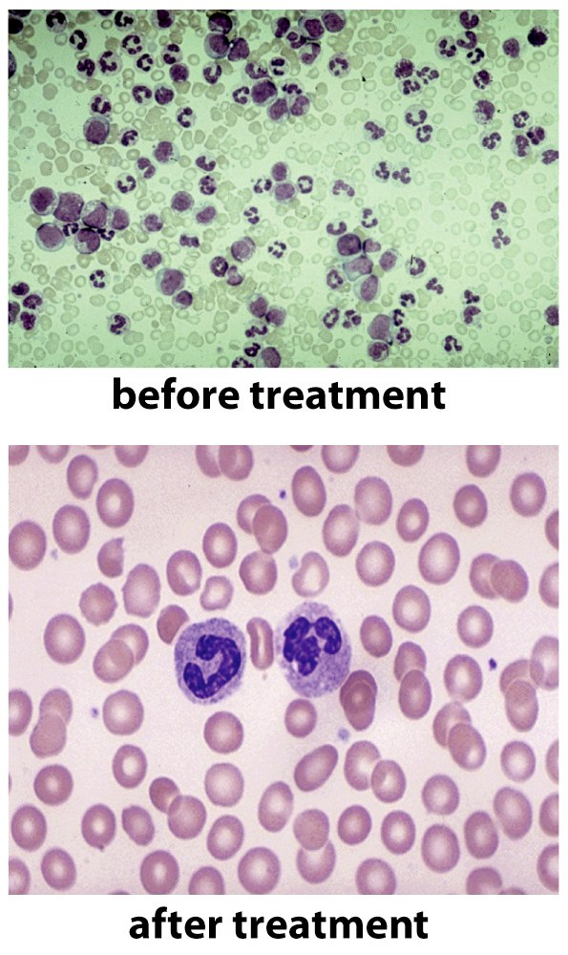
This shows a hematological response!
Figure 16.25a The Biology of Cancer (© Garland Science 2007)

Slide 25
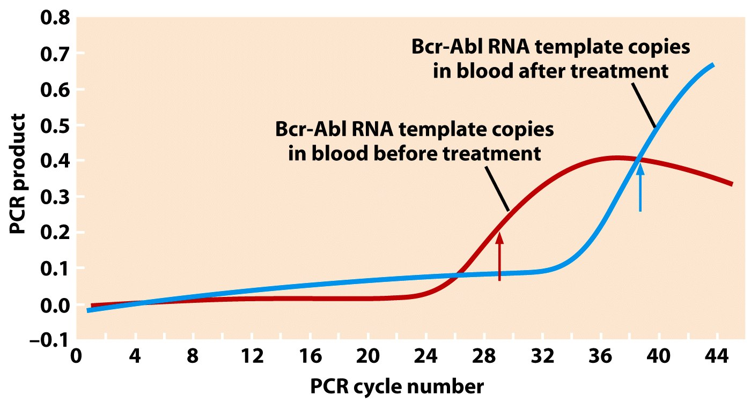
This shows a cytogenetic/fusion gene response!
Figure 16.25b The Biology of Cancer (© Garland Science 2007)

Slide 26
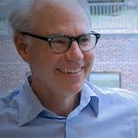
Gleevec
Developed by Brian Druker and Charles Sawyers. Earned them national recognition—many top cancer awards.

Slide 27
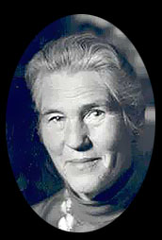
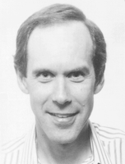
Imatinib Discovery Timeline
1984 BCR and ABL genes identified on chromosomes 9 and 22. BCR-ABL fusion oncogene
Philadelphia Chromosome
1960 Nowell and Hungerford identify an abnormal chromosome in CML patient’s leukemia cells.
Philadelphia Chromosome
1973 Janet Rowley identifies a translocation between chromosomes 9 and 22 in the Philadelphia Chromosome
1993-2001 Development and FDA approval of Imatinib (Brian Drucker).

Slide 28
Proto-oncogenes/oncogenes
Growth factors
Growth factor receptors
G-proteins
Cytoplasmic kinases
Transcription factors
Cell cycle or cell death proteins

Slide 29
In multicellular eukaryotes cell specialization is the result of selective gene expression.
-All cells contain the same genome, but each cell type ( or cell that finds itself in a unique environment) will express a select subset of all of its genes.

Slide 30
Most gene expression regulation occurs at the beginning of gene expression---with control of transcription.
Transcription factors regulate which genes get transcribed at any given time, in any given cell.

Slide 31
Examples
MAP kinase can enter the nucleus and phosphorylate TFs
e.g. TFs called Jun and Ets (several different members of a protein family)
Jun and Ets are considered early genes/proteins in the activation of transcription.

Slide 32
There is a mini-signal transduction cascade that occurs in the nucleus!
Jun and Ets are needed to activate transcription of later acting TFs (Myc, Fos)
Myc and Fos are considered intermediate genes/proteins.

Slide 33
Delayed or late genes/proteins are most directly involved in transcription activation or cell cycle activation.
E2F (discussed soon!)
Cyclins, CDKs

Slide 34
Remember Myc?...
One of the proto-oncogenes made oncogenic by amplification.
(at the DNA level via double minutes, and HSR chromosomes)
And at the mRNA level by translocation next to the strong IgH gene promoter, in the 8;14 translocation.

Slide 35
Try to draw a complete signal transduction pathway where Ras is a central player.
Ras-MAPK pathway.
Be sure to think of how a proto-oncogene can become an oncogene at each step in the signal path and what the effect might be.

Slide 36
Finally…
Some oncogenes encode proteins which directly regulate cell proliferation or survival.
Genetic analysis of some tumor cells (brain, breast, lymphoma) show amplification of CDK4, CYCLIND1, and other related cyclin-cdk combinations.
---In a sense, they bypass the whole signal pathway.

Slide 37
A new category of genes/proteins
Anti-apoptotic proteins
--Apoptosis needs “fail safe” inhibitors to protect against excessive cell death.

Slide 38
Proto-oncogenes/oncogenes
Growth factors
Growth factor receptors
G-proteins
Cytoplasmic kinases
Transcription factors
Cell cycle or cell death proteins

Slide 39
BCL2
BCL2—encodes a cell survival protein, Bcl2 which associates with mitochondria.
A chromosome translocation in non-Hodgkins lymphoma cells greatly increases expression of BCL2. t(14;18) It places Bcl-2 right next to IgH gene promoter!
Cell expressing excess Bcl2 protein keep dividing rather than responding to apoptosis signals…

Slide 40
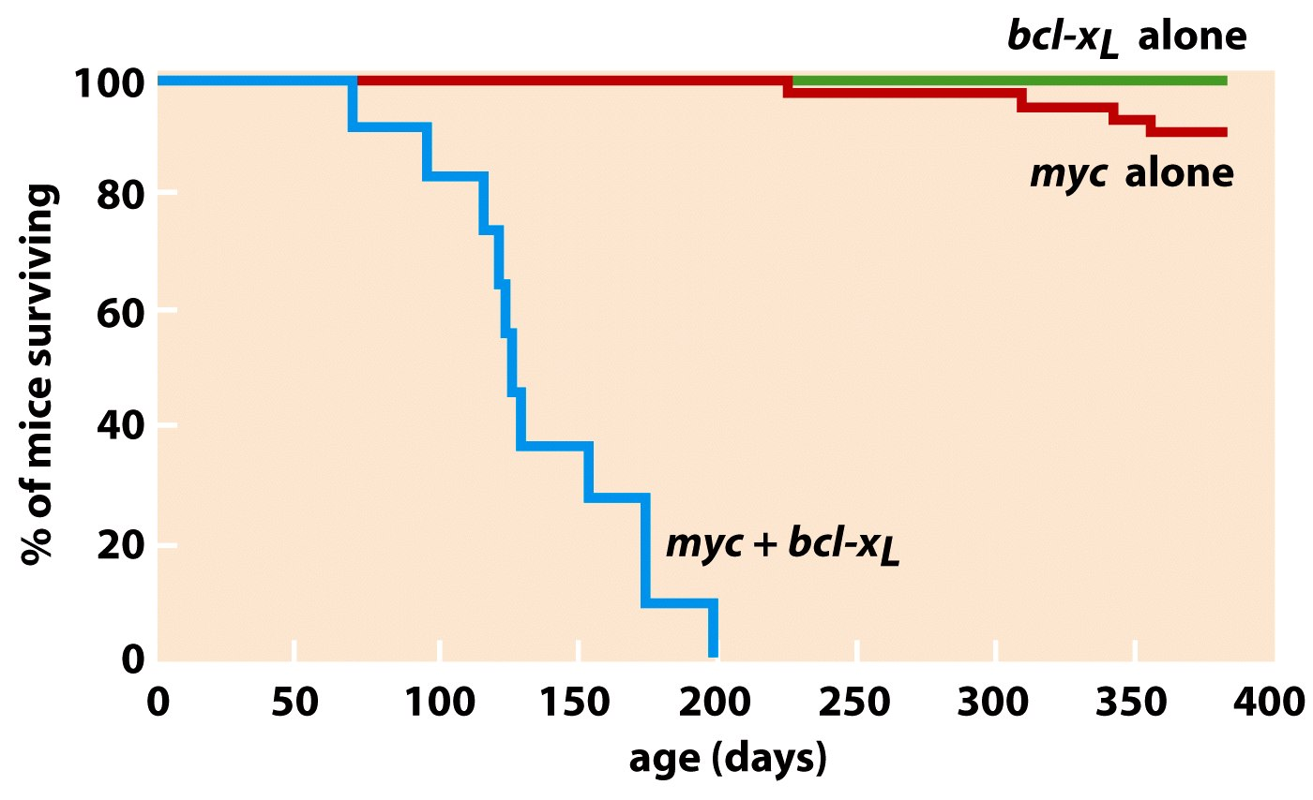
(A relative of bcl-2)

